Slide 1
Deadlock
Week 7

Slide 2
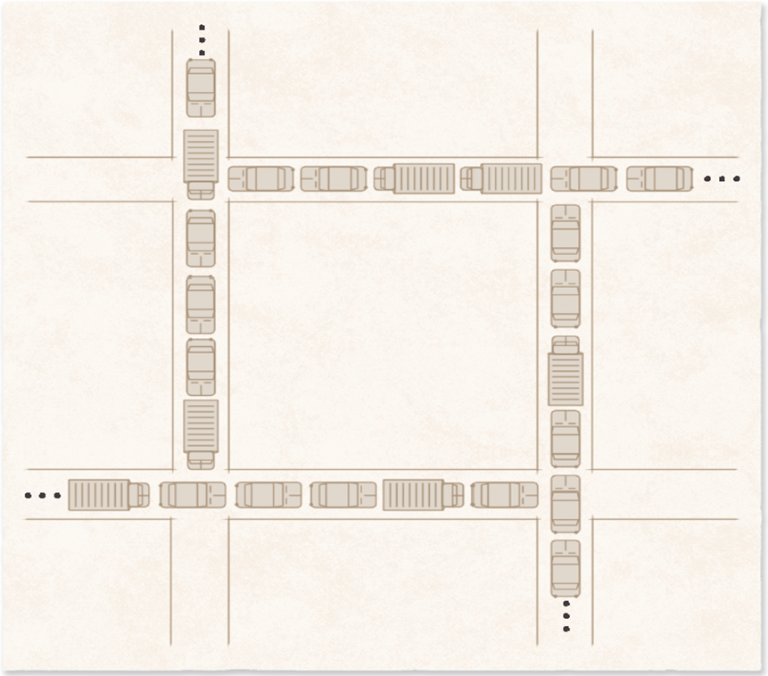
Deadlock
Deadlock: processes are each waiting for something that will never happen, because they're waiting on each other
System deadlock: one or more processes are stuck this way
Like gridlock: every car is waiting for the car ahead to move, so nobody moves
Traffic deadlock example.

Slide 3
Deadlock in Spooling Systems
A spooler holds print jobs in a waiting area (a spool) until the printer is ready
If the spool fills up with half-finished jobs, the printer waits for a whole job and the jobs wait for space
Fix: stop taking in new jobs when the spool is nearly full, and start printing before a job is finished
Video streaming uses the same idea: it starts playing before the whole video has downloaded (Week 6, bounded buffer)

Slide 4
Examples of Deadlock
Two programs each need the same two files
  Program A opens the spreadsheet and waits for the report. Program B opens the report and waits for the spreadsheet
Two bank transfers at the same moment
  One moves money from account 1 to 2 and locks account 1 first. The other moves money from 2 to 1 and locks account 2 first. Each waits for the other's lock
Everyday versions: two roommates, one holding the TV remote and waiting for the charger, the other holding the charger and waiting for the remote
Historical note: textbooks often use two tape drives. Still worth knowing because the example works the same with any two resources

Slide 5
Dining Philosophers: A Recap
Five philosophers, five chopsticks, and each needs both chopsticks next to them to eat (Week 6)
A good solution must:
  Never deadlock
  Never let anyone starve
  Never let two philosophers use the same chopstick at once (mutual exclusion)

Slide 6
Dining Philosophers: A Solution
Number the chopsticks 1 to 5, and every philosopher picks up the lower-numbered chopstick first
Then nobody can be waiting in a full circle, so deadlock is impossible
This is called resource ordering. It breaks the circular wait condition (later this week), and real systems use it too
Several earlier attempts didn't work. They led to deadlock, to everyone trying and failing over and over (livelock), or to only one person eating at a time
  Curious about those attempts? See the links in the notes, or on the web page
Notes:
E.W. Dijkstra: Hierarchical ordering of sequential processes (EWD 310), where the problem first appeared: https://www.cs.utexas.edu/~EWD/transcriptions/EWD03xx/EWD310.html
Wikipedia: Dining philosophers problem: https://en.wikipedia.org/wiki/Dining_philosophers_problem

Slide 7
Starvation and Livelock
Indefinite postponement (starvation): a process waits forever because the system keeps choosing others
  Fixed with aging: raise its priority the longer it waits (Week 5)
Livelock: processes keep reacting to each other, so they're busy but make no progress
  Like two people in a hallway who keep stepping the same way to let each other pass
Deadlock: nobody moves. Livelock: everybody moves, but nobody gets anywhere

Slide 8
Resource Concepts
Preemptible resources can be taken away without losing work
  The CPU and memory: the OS can pause a process and give them to someone else
Nonpreemptible resources cannot be taken away without losing work
  A printer halfway through a page, a file in the middle of being saved, or a lock on a bank account mid-transfer
Deadlocks happen over nonpreemptible resources

Slide 9
Four Necessary Conditions for Deadlock
Deadlock can only happen if all four are true at once:
  Mutual exclusion: only one process can use the resource at a time. Only one person can hold the remote
  Hold and wait: a process keeps what it has while waiting for more. Holding the remote while waiting for the charger
  No preemption: you can't take a resource away. Nobody grabs the remote out of someone's hand
  Circular wait: a circle of processes, each waiting on the next. Each roommate waits on the other
Break any one of the four, and deadlock cannot happen

Slide 10
Deadlock Prevention
Prevention: design the system so one of the four conditions can never be true
Mutual exclusion usually can't be removed, since some things really can only be used by one at a time
Deny hold and wait: ask for everything you need at once. Wasteful, because resources sit unused
Deny no preemption: take resources away when needed. Processes may lose work and have to restart
Deny circular wait: number the resources and always request them in order. Usually the most efficient choice, and the dining philosophers solution

Slide 11
Deadlock Avoidance
Avoidance: before granting a request, check whether it could lead to deadlock later. If it could, make the process wait
Safe state: the OS can guarantee every process will be able to finish
Unsafe state: not deadlocked yet, but the OS can't guarantee everyone finishes
Dijkstra's Banker's algorithm only grants requests that keep the system in a safe state
  Like a bank that only lends money if it can still cover every customer's maximum loan
Notes:
E.W. Dijkstra: The mathematics behind the Banker's Algorithm (EWD 623): https://www.cs.utexas.edu/~EWD/transcriptions/EWD06xx/EWD623.html

Slide 12
Banker's Algorithm: An Example
12 of a resource in total. Each process says up front the most it will ever need
Process | Most it needs | Holds now | May still ask for
P1 | 4 | 1 | 3
P2 | 6 | 4 | 2
P3 | 8 | 5 | 3
Total in use |  | 10 | 2 free
Safe: P2 can finish with the 2 free, and give back 6. Then P1 can finish, then P3
If P1 asks for 1 more now, only 1 would be free and no one could be sure to finish. Unsafe, so P1 waits
Notes:
Banker's algorithm example. 12 units total. P1: max 4, holds 1, may ask for 3. P2: max 6, holds 4, may ask for 2. P3: max 8, holds 5, may ask for 3. 10 in use, 2 free. Safe order: P2, P1, P3. Granting P1 one more would leave 1 free, which is unsafe.
E.W. Dijkstra, The mathematics behind the Banker's Algorithm (EWD 623): https://www.cs.utexas.edu/~EWD/transcriptions/EWD06xx/EWD623.html

Slide 13
Weaknesses of the Banker's Algorithm
It needs a fixed number of resources and a fixed group of processes
Every process must know its maximum needs in advance
Requests are only promised to be granted within some "finite time", which could be a long wait
These rules don't fit real computers, where programs start and stop all the time, so it's rarely used as is

Slide 14
Deadlock Detection
Detection: let deadlocks happen, notice them, then fix them
The OS keeps a graph of who is waiting for whom (a wait-for graph). A circle in the graph means deadlock
The check can run every time a resource is requested, which catches deadlock early but adds overhead, or every so often
Detection finds which processes and resources are involved, so recovery knows what to fix

Slide 15
A Wait-For Graph
P1
waits for
waits for
P3
P2
waits for
The arrows form a circle, so P1, P2, and P3 are deadlocked
Notes:
Wait-for graph: P1 waits for P2, P2 waits for P3, and P3 waits for P1. The arrows form a circle, so the three processes are deadlocked.

Slide 16
Deadlock Recovery
Stop processes: end all of them, or one at a time until the circle is broken
Take resources back: give a resource to another process, then let the first one try again
Roll back: return a process to a saved checkpoint and restart it from there (File Systems week)
Suspend and resume: put a process on hold without losing its work

Slide 17
Choosing Which Process to Stop
Things to consider:
  Its priority
  How long it has run, and how much it has left
  What resources it holds, and what it still needs
  How many processes have to be stopped
  Whether someone is waiting on it, like an open app, or it is a background job
Watch out for starvation: if the same process is picked every time, it never finishes

Slide 18
What Real Systems Do
Linux and Windows mostly don't stop deadlocks between your apps. Deadlocks are rare, and the checks would slow everything down, so programs are left to avoid them (the ostrich approach)
  If an app freezes this way, you force quit it (Week 2)
Inside the kernel, Linux uses a tool called lockdep to catch locks taken in the wrong order before they cause a deadlock
Databases detect deadlocks and cancel one of the transactions involved
  That's why an app sometimes says "something went wrong, please try again"
Notes:
Linux kernel documentation: Runtime locking correctness validator (lockdep): https://docs.kernel.org/locking/lockdep-design.html
PostgreSQL: Explicit locking and deadlocks: https://www.postgresql.org/docs/current/explicit-locking.html
Microsoft: SQL Server deadlocks guide: https://learn.microsoft.com/en-us/sql/relational-databases/sql-server-deadlocks-guide

